Slide 1
Writing Scientific Reports
Katrina Attwood – based on slides by Anna Bramwell-Dicks, Stefano Pirandola, Steve King and Helen Petrie

Slide 2
Contents
Structure of the Report
Writing Style
Process of Writing

Slide 3
Structure of the Report

Slide 4
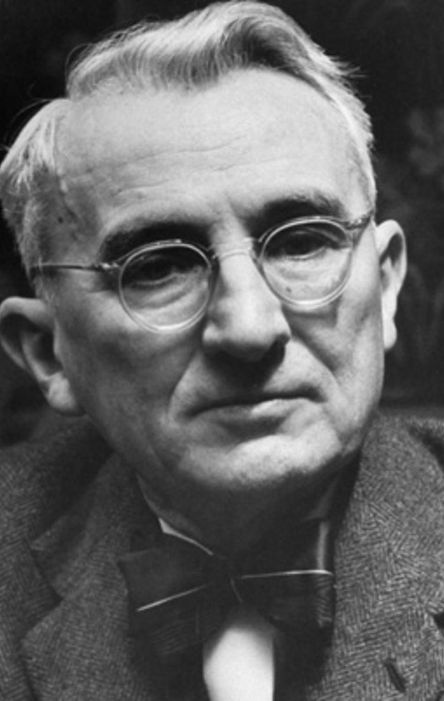
The Rule of Three
Tell the audience what you’re going to tell them, then tell them, then tell them what you just told them.
Dale Carnegie (1888-1955), Author of How to Win Friends and Influence People

Slide 5
Beginning: Tell them what you’re going to tell them
Title Page
Abstract
Acknowledgements
Table of Contents
Lists of Tables, Figures, Equations
Introduction

Slide 6
Beginning
Title Page
Must include:
Title
Your name
Your supervisor’s name
Date
Degree title
Declaration of word count
Abstract
Acknowledgements
Table of Contents
Lists of Tables, Figures, Equations
Introduction

Slide 7
Beginning
Title Page
What is it?
Brief summary of the work, context and findings of the project
What to include?
Problem
Method
Findings
Important Conclusions
What not to include?
References, jargon, acronyms
Abstract
Acknowledgements
Table of Contents
Lists of Tables, Figures, Equations
Introduction

Slide 8
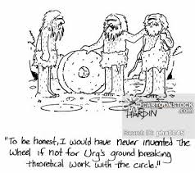
Beginning
Title Page
Abstract
Acknowledgements
Table of Contents
Lists of Tables, Figures, Equations
Introduction

Slide 9
Beginning
Title Page
Don’t create manually
Headings
Only useful to the reader if the pages are numbered!
Abstract
Acknowledgements
Table of Contents
Lists of Tables, Figures, Equations
Introduction

Slide 10
Beginning
Title Page
What is it?
Summary of the project
What should it include?
Statement of what the project is setting out to investigate
Research question/hypothesis
Motivation
Parameters or limitations of the project
How you are going to approach the problem
Roadmap of the project report
Abstract
Acknowledgements
Table of Contents
Lists of Tables, Figures, Equations
Introduction

Slide 11
Middle: then tell them
Literature Review
Main Body

Slide 12
Middle
Literature Review
What is it?
Selective analysis of existing research
What should it include?
Broad issues
Typical approaches to the problem
Studies that overlap with yours
Studies that directly inform your work
Your opinions:
Strengths, weaknesses, limitations of the existing work
Main Body

Slide 13
Middle
Literature Review
What is it?
Report of what you did, and why
Structure
Depends on type of project
Engineering project (s/w or h/w)
Design, implementation, testing/evaluation
Research project
Method, results, analysis of results
Main Body

Slide 14
Ending: tell them what you just told them
Discussion and Conclusions
Further Work
References
Appendices

Slide 15
Ending
What is it?
Discussion of the project’s findings
What it should include
Outcomes
Wider implications
What it should not include
New concepts, ideas or theories
Discussion and Conclusions
Further Work
References
Appendices

Slide 16
Ending
What is it?
Recommendations of where this work could go in the future
For the dwarves sitting on your shoulders
What it should include
What you would do next
If you had another six months
What you would do next
If the sky is the limit
Discussion and Conclusions
Further Work
References
Appendices

Slide 17
Ending
IEEE style
See the lecture notes from Week 3
Don’t create manually
Discussion and Conclusions
Further Work
References
Appendices

Slide 18
Ending
May contain
Code listings
Raw data
Questionaires
Detailed guidance on use of software/method you have developed
Discussion and Conclusions
Further Work
References
Appendices

Slide 19
Don’t forget…
All CS projects need to include a “Statement of Ethics”
Even if it is “There are no ethical implications in this work”
Ethical principles
Do no harm
Informed consent
Confidentiality of data
See Alistair Edwards’s slides from Week 7

Slide 20
Writing Style

Slide 21

Know Your Reader
Helpful to have a reader in mind
“Intelligent general reader”
Remember you are the expert …
… but don’t patronise your reader
And don’t show off
“Dear Dr Attwood, I thought you would be interested in my work on …”
Read your work back, with your reader in mind

Slide 22
Keep things simple
I think it is fine to use a certain amount of first person (I, me, we, our etc…)
But beware of things like “When I conducted this experiment, the results showed that the hypothesis was correct”
Would the results show the same if someone else did it?
Keep words as simple as possible
Except for technical terms
Keep sentences short
Break the argument down into logical parts, so that the reader can follow it easily

Slide 23
Finding your voice
Avoid convoluted style, full of complex terms
“If skin deformation is a critical factor for roughness perception (Taylor and Lederman, 1975), then it would seem reasonable to argue that roughness perception in virtual reality might be more similar to roughness perception in the physical world via a probe, than via a finger” (Anonymous, supplied by Helen Petrie)
Scores 27 on Flesch Ease-of-reading index
Scores out of 100, high is good
This is not good

Slide 24

Be as active as you can …
Avoid too much use of indirect statements (“passive voice”
NOT “The following theorem can now be proved”
RATHER, “We can now prove the following theorem”
Also, avoid indirect use of words like “utilized”, “perform”
NOT “Tree structures can be utilized for dynamic storage of terms”
RATHER “Terms can be stored in dynamic tree structures”
NOT “Local packet transmission was performed to test error rates”
RATHER “Error rates were tested by local packet transmission”

Slide 25
Precision and Vigour
Scientific style is as precise as possible:
Define specialised terminology and use it precisely
Avoid vague terms
“The web users tended to”
Avoid colloquially/culturally specific expressions
“training wheels interfaces” … huh?
Make sure that you know the meaning of complex words you use
And do not use a more “fancy” word to sound posher…
Write positively about what you have achieved
“This project did X”, rather than “this project tried to do X”

Slide 26
Remember the reader…
Some people can only write from the beginning
Try to keep the reader in mind
And see things from his/her point of view
Read things back
Rewrite earlier sections if necessary
Your job is
To persuade the reader that this is an interesting document/project
To lead the reader through the information you are presenting

Slide 27
Remember the reader …
Provide definitions at the beginning
Acronyms
Context-specific terminology
Keep your focus clear
Explicitly explain why X is relevant to your project
Only include things that are relevant to your project
Keep the reader with you
Provide scaffolding
And signposts

Slide 28
Keeping the reader with you
Keep the structure of your paragraphs clear
Summary of main point
Elaboration
Conclusion
Lead through to the next point
Does each sentence have a clear structure?
Obvious subject (noun-phrase)
Main verb-phrase

Slide 29
Definitions, abbreviations and acronyms
Define technical terms early in the report
Use terms according to the definition
Don’t vary your terminology – reader may think you mean different things!
Set up your abbreviations early
Table of abbreviations at the beginning is the best way
Clarify on first use
Use them
But don’t use too many

Slide 30
If there is disagreement
Discuss different researchers’ definitions, concepts etc
In the literature review
In the body of the report, if relevant to your discussion there
Make it clear where you stand
NB: Conceptual analysis and definition of new terms may form part of the contribution of your project

Slide 31
Be politically correct
If writing about human beings, use non-sexist terminology
He/she, (s)he
Looks a bit old-fashioned, these days
Using “they”, “their” etc. is ugly, but might be better
If writing about particular groups of humans, personalise them
NOT “The elderly cannot see colours”
RATHER, “Elderly people cannot see colours”

Slide 32
Writing style – points to remember
One idea per sentence/paragraph
One topic per section
Simple, logical organisation
Short words
Short sentences with simple structure
Short paragraphs
Avoid buzzwords, clichés and slang
Avoid excess, in length or style
Omit unnecessary material
Be specific, not vague
Break these rules if there is a good reason to do so

Slide 33
Headings
Make them meaningful
NOT “Background reading”
RATHER “Previous Research on Web Accessibility and Usability”
Do not assume that the reader has read the headings
NOT “This area of research has received relatively little attention…”
BUT “Web accessibility and usability have received relatively little attention…”

Slide 34
Figures and Tables
Can be very helpful to the reader
But it needs to be clear why they are there
Don’t assume that every picture tells a thousand words
Must have a clear, stand-alone caption
If taken from a published source, acknowledge this in the caption
Must be referred to, and used, in the text
Should be information-rich but not cluttered

Slide 35
Check and re-check
Use spell-checkers
But remember that they are stupid
Read your work yourself
Out loud
Makes it very clear where there are issues with the sense and style
Have someone else proof-read
Intelligent general reader
Return the favour …
Don’t rely on your supervisor as a proof-reader

Slide 36
Marking
Marking criteria are given at http://www.cs.york.ac.uk/projects/index.php
Make sure you know what they are
If you are deviating from the standard section headings etc, make sure that the marker can find what he/she needs
Remember that the marker has a lot of projects to mark
Typically 8 or 9
Not just projects (s)he has supervised
And time is very short

Slide 37
The Flowers Paradigm (1997)
Model of how people write
Betty S. Powers, Professor of Creative Writing at English Department of University of Texas, Dallas
What causes writers to get stuck?
Competing energies
Writing freely and creatively versus writing well
Need to separate the energies

Slide 38
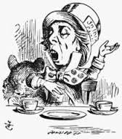
The “Mad Person”
Generates ideas
Captures thoughts when they come
Usually in the shower!
Works with spontaneity, without inhibitions
Believes all things are possible
Allow this person to write freely
The Mad Hatter, from Lewis Carroll’s Alice in Wonderland, illustrated by Sir John Tenniel, 1865

Slide 39
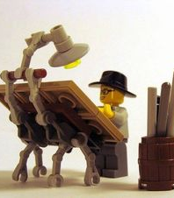
The Architect
Creates order from the mad person’s chaos
Structures ideas into argument
Sees the whole
Paragraph-level thinking
Makes the direction clear
So that the reader can see where things are going

Slide 40
The “Mad Person”
Interrupts
Let him/her in
Pay attention
See how the idea fits in the structure

Slide 41
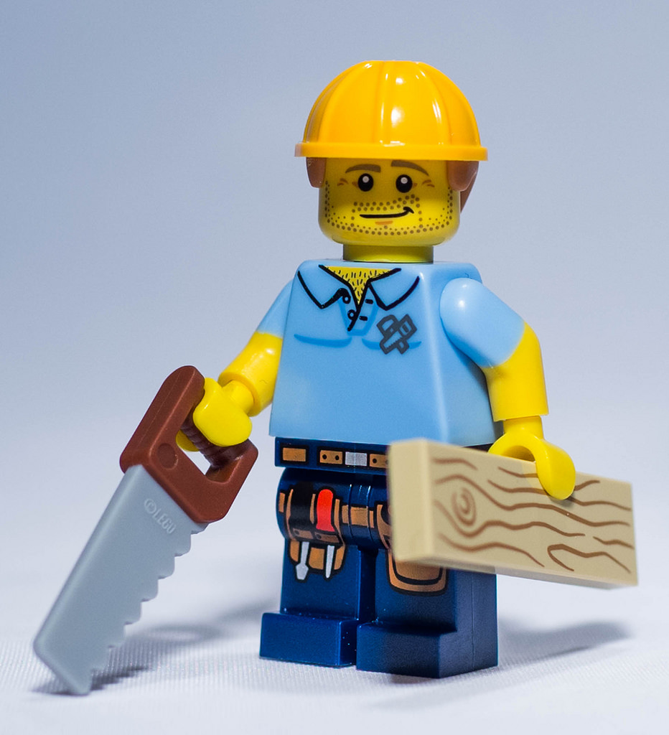
The Carpenter
Crafts sentences and paragraphs
Makes the argument logic clear
Considers the audience
Wants to make everything hold together and have a nice feel

Slide 42
The “Mad Person”
Has another idea
Let him/her in
Pay attention
See how the idea fits in the structure
Craft it nicely

Slide 43
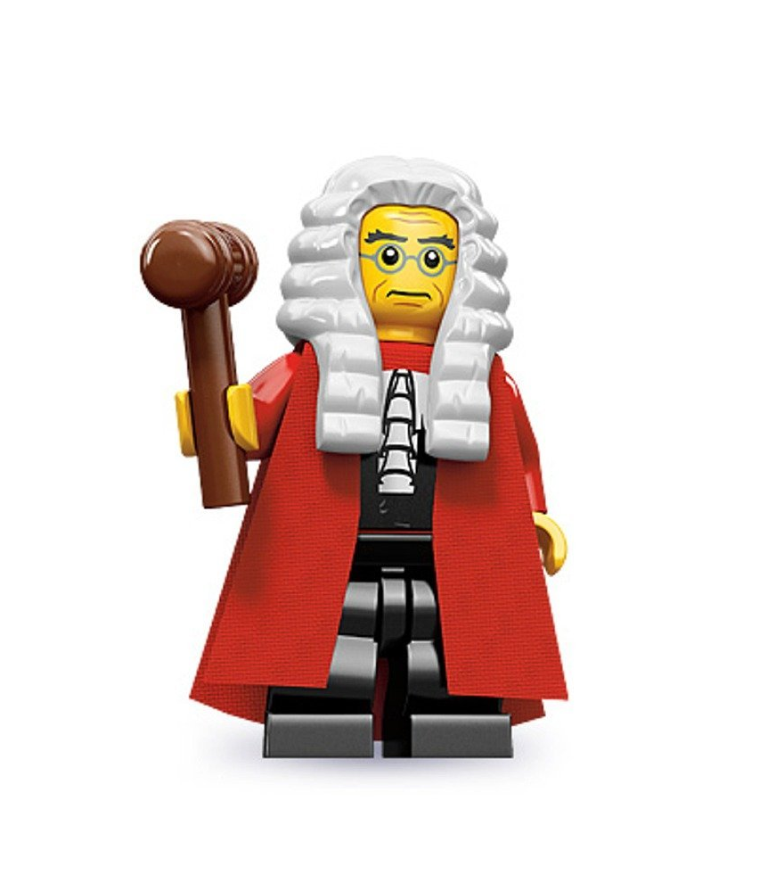
The Judge
Nitpicks
Considers every detail
Applies rules and signposts
Grammar
Spelling
Punctuation
Do not let the Judge interrupt until the end of the process

Slide 44
The “Mad Person”
Has just one last wonderful idea…
Once the Judge has done his/her thing, you have to STOP the Mad Person
Don’t let him/her in
YOU HAVE TO END…

Slide 45
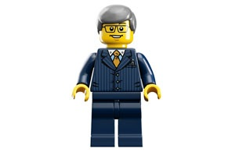
Managing Your Writing
Set deadlines
With some slack
Keep the deadlines
Write a little and often
Try to avoid the last-minute panic
Create a rhythm for your work
Do other things in your day – eating, exercising, living
Write sections up as they are ready
Stop where it is easy to restart
Get feedback – supervisor, colleagues

Slide 46


And finally …

